Slide 1

Project Data Acquisition & Data Wrangling
Rented Bike users

Slide 2
Introduction
Data acquisition and data wrangling are foundational steps in the data analysis process.
Data acquisition
involves gathering raw data from various sources such as databases, files, APIs, or even manual entry. This process requires identifying relevant data sources, retrieving the data, and ensuring its integrity.
Data wrangling
involves the process of cleaning, structuring, and enriching raw data into a more usable format for analysis or other purposes. It involves tasks such as removing duplicates, handling missing values, transforming data types, merging datasets, and enriching the data so that it becomes more structured, standardized, and usable.

Slide 3
How to get start
Google Colab provides a powerful and convenient platform for data scientists to perform data analysis, develop machine learning models, and collaborate with team members, all within a cloud-based environment that offers free access to computational resources.
To work with Google Colab import drive and mount at one drive to store dataset (excel and csv files)
from google.colab import drive
drive.mount("/content/drive")

Slide 4
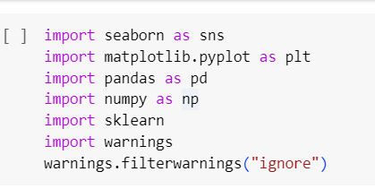
Import the important liabraries
seaborn and matplotlib are both libraries used for plot the dataframe
pandas and numpy are used for different wrangling methods mathematical method
sklearn for data analysis
Warnings to avoid unnecessary warnings while running the codes

Slide 5
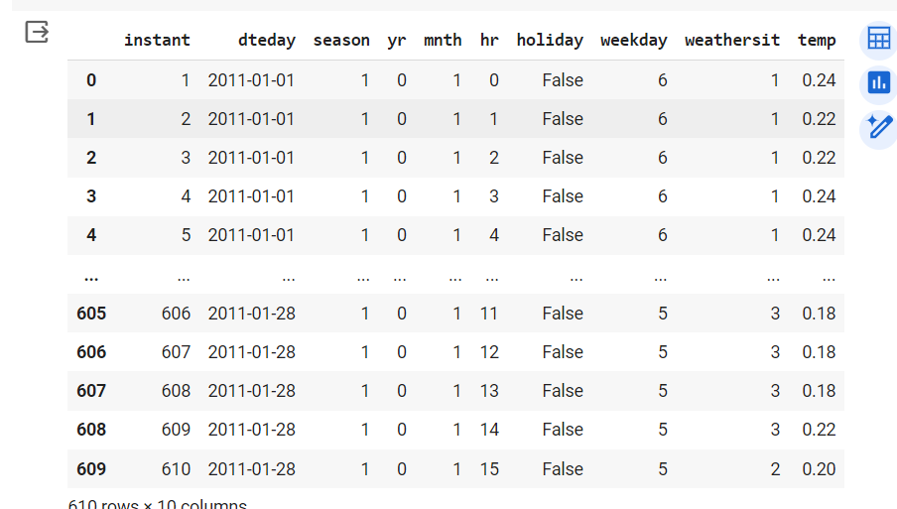
Access Data from onedrive
data1=pd.read_excel("/content/drive/MyDrive/DatacquisitiondataWrangling/dataset_1.xlsx")

Slide 6
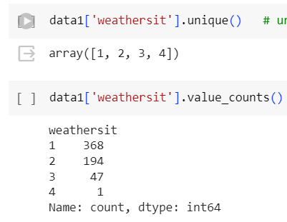
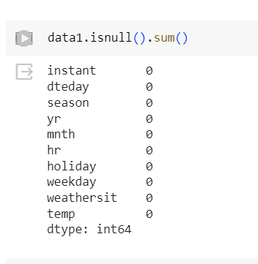
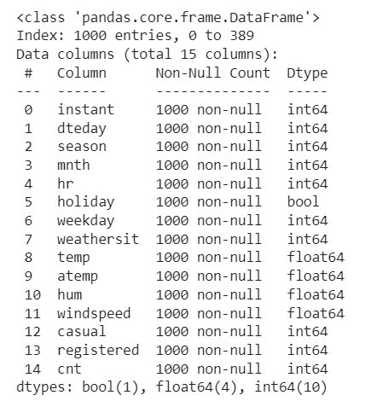
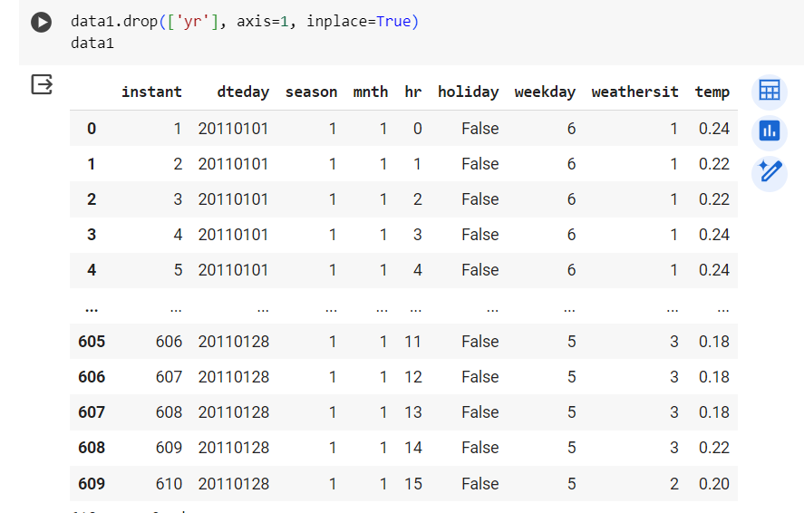
Wrangling Method to clean and make the organized dataset
To find null values
Get info of the dataframe
Covert datatype
Shape of dataframe
Unique
Drop unwanted columns and row
Value counts for unique data
Round the decimal point
Find the mean median to replace the null value
Std deviation
Ploting the dataframe
Detect and remove outliers
Merging the datasets
Concatenate datasets

Slide 7
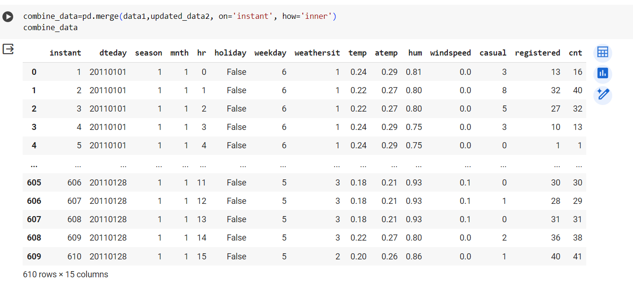
Combine or merge datasets with same row count

Slide 8
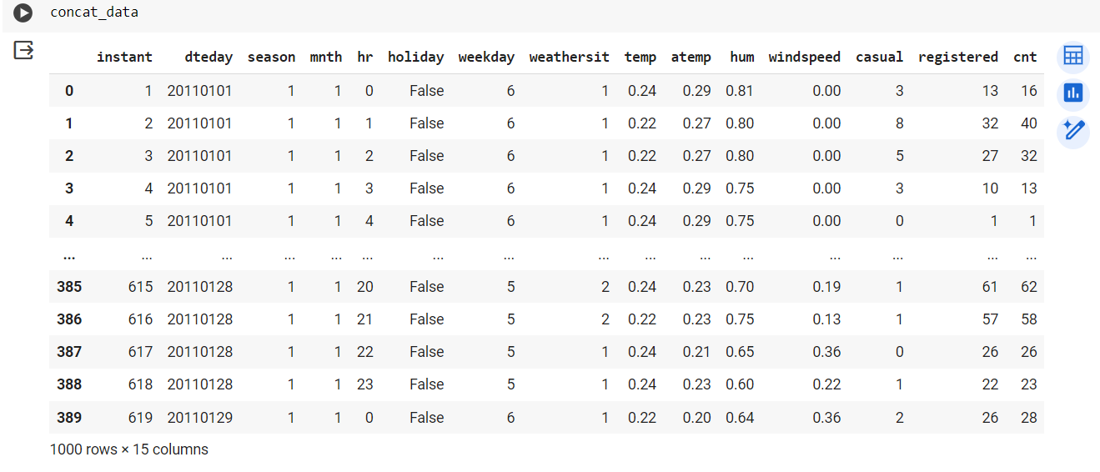
Concatenate datasets with 1000 rows

Slide 9
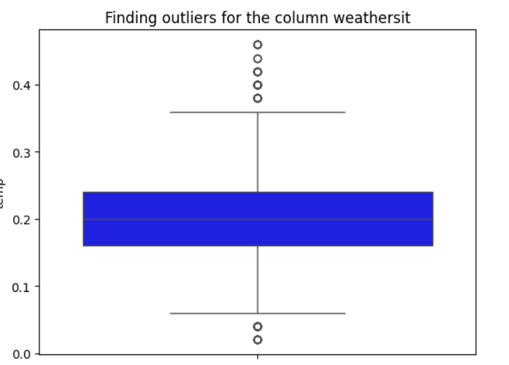
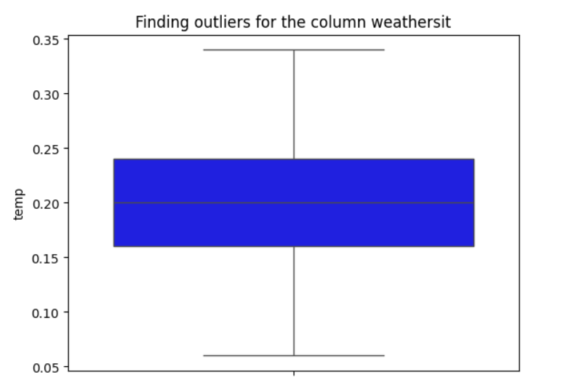
Detect and remove outliers old shape (999, 15) new shape (918, 15)

Slide 10
Conclusion
Effective data acquisition and data wrangling practices are essential for ensuring the quality, relevance, and usability of data in the data science lifecycle. They lay the groundwork for successful analysis, modeling, and decision-making processes.
Total rental register bike users is most important column in the datasheet. Customize the business module for rental registered bike user

Slide 11


Thank you

